Slide 1


What is FAIRagro?
NFDI consortium for the agrosystem sciences.
Foster a cultural change towards FAIR & collaborative RDM.
Provide interoperable infrastructures.
Findable
Accessible
Interoperable
Reusable
Establish standards, guidelines and best-practices.
Enable reproducible research and data analysis workflows.
Provide legal certainty to data providers and users.
Ensure data quality via domain-specific measures.
Illustration: Photo by Ümit Yıldırım licensed under the Unsplash license
Notes:
Slide content: explain what is FAIRagro and the goals of the consortium
Extra notes:
FAIRagro is the NFDI consortium for the agrosystem sciences.
With the FAIR principles, we aim to enhance collaboration, accelerate research progress, and address global challenges related to food security, climate change, and sustainable agriculture.
What is the NFDI: The National Research Data Infrastructure (NFDI) aims to make data from science and research available, network it and thus make it usable in the long term. Institutions from various research areas are involved in the NFDI. They are working on services, training opportunities for researchers and standards for handling data.
FAIRagro objectives:
1. Cultural Change
Enabling researchers, students, and infrastructure providers to achieve an open and sustainable research data life cycle and foster a cultural change towards FAIR and collaborative RDM.
2. Solutions for the Community
Continuously identify RDM challenges in the agrosystem community and provide solutions via continuously agile developed RDM services to meet the needs of our community.
3. Findability and Exchange
Improving the findability of published research data as well as existing data repositories and providing discipline-specific interoperable infrastructures to enable standardised data exchange.
4. Interoperability
Ensuring the interoperability of an agrosystem research data infrastructure within related domains in the agricultural sciences and within NFDI as well as with the overarching NFDI and international initiatives.
5. Orientation for Researchers
Developing and establishing a set of standards, guidelines and best-practices as guidance for researchers to promote and enable FAIR RDM and infrastructure.
6. Legal Security
Providing legal certainty to infrastructure providers, data providers and users for the publication and reuse of sensitive data.
7. Quality assurance
Ensuring research data quality via domain-specific measures of quality control and establish a quality feedback and curation system to facilitate the reuse of research data by agricultural scientists.
8. Reproducibility
Enabling reproducible research results, the deployment and publishing of models and data analysis workflows, and contributing to the reproducibility of research results.
9. Internationalisation
Contributing to and leading European and international developments of RDI in agrosystem and agricultural research with the goal of and playing a lead role.

Slide 2
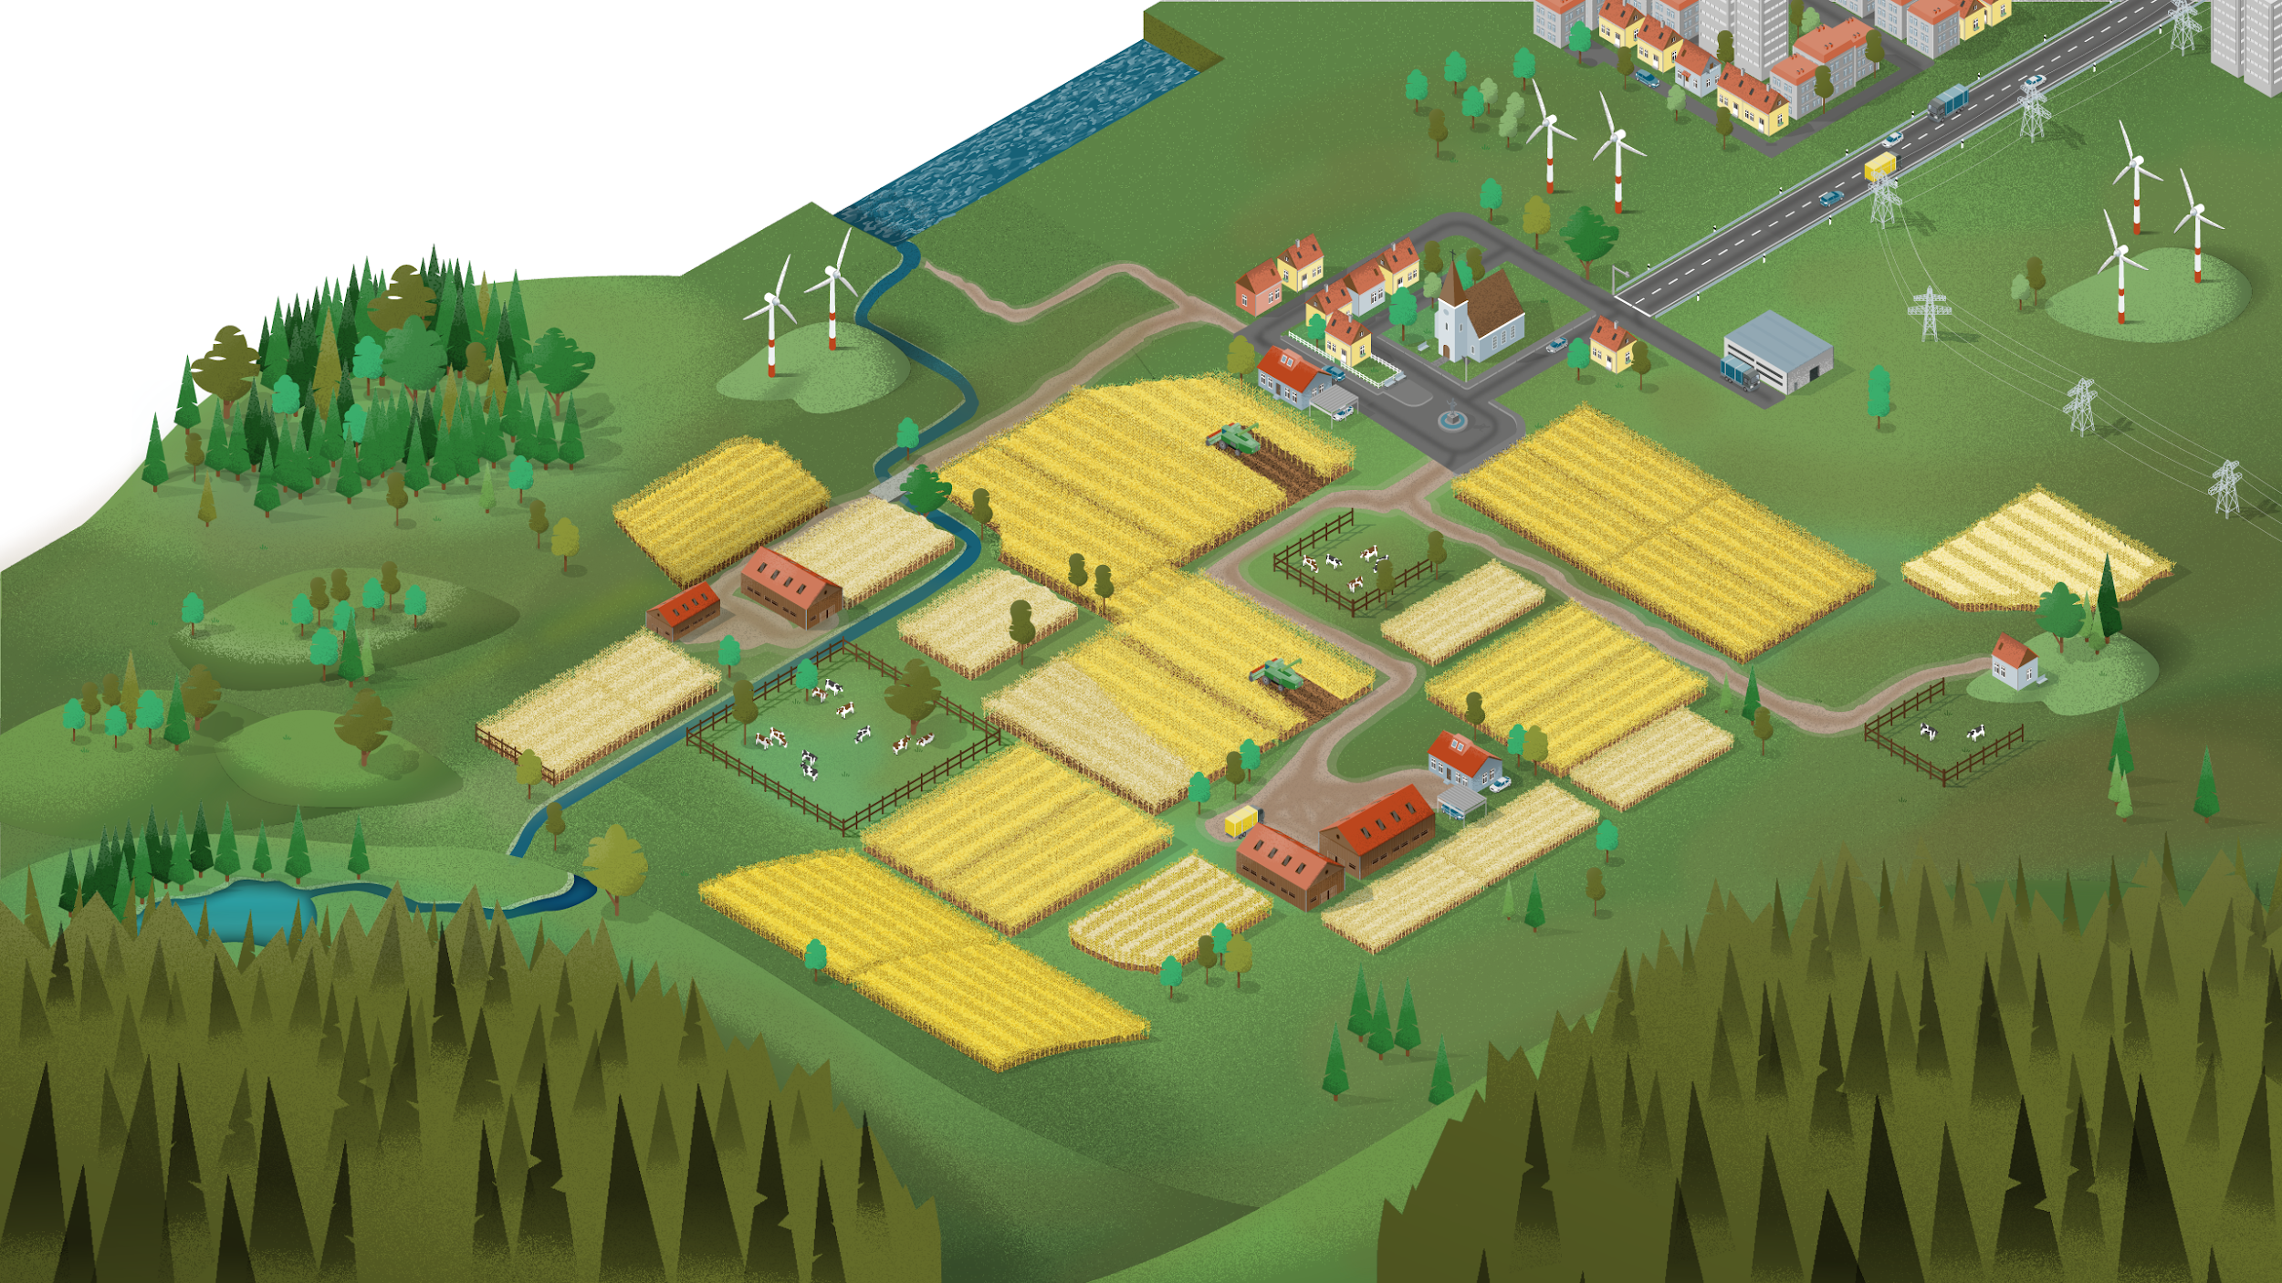







What is FAIRagro?
Scales
Subjects and disciplines
Data categories
…
Agronomy
Crop physiology/ecology
Plant pathology
Plant nutrition
Crop breeding
Crop functional genetics
Crop bioinformatics
Soil biol./chem./physics
Soil microbiology
Soil hydrology
Agroecology
Agrobiodiversity
Remote sensing
Modelling
...
time-series
geo data
Region
Plant
Landscape
farming 4.0
sensitive data
Environment
Soil
Farm field
Crop trial
legacy data
omics data
Plants
Genes
…
Illustrations: “time series chart“” by I Putu Dicky Adi Pranatha, “GPS“” by Desi Ratna, “wifi“” by El Maestro Design, “Tractor“” by parkjisun, “critical data“” by Icon Designer,
“sheet“” by Hary Murdiono JS and “DNA“” by karl from Noun Project (CC BY 3.0)
Notes:
Slide content: explain what are the different approaches from the consortium with the data generated in the agrosystem sciences
Extra content:
Agrosystems are agriculturally used landscapes and ecosystems which require an integrated systems perspective to develop sustainable crop production systems and interventions considering agri-environment interactions (plant, soil, microbiota, abiotic and biotic environment) and relationships across scales (spaces, time and organisations).
The FAIRagro domain spans different scales, from genes and crop trials to fields and regions.
Therefore, FAIRagro covers multiple disciplines within agrosystem sciences that handle various data categories, such as time series data, geospatial data, and Farming 4.0 data (i.e. remote sensing and field robotics), as well as legacy data (e.g. from long-term experiments), omics data, and occasionally personal data.

Slide 3
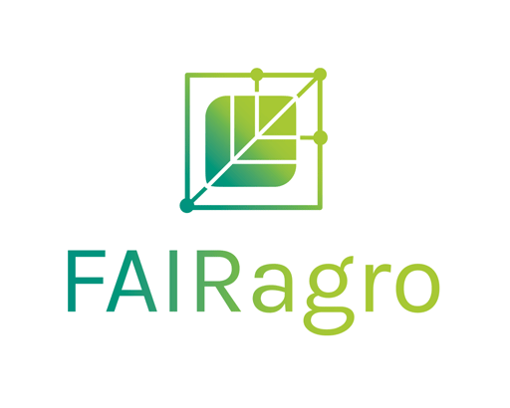
What is FAIRagro?
FAIRagro partners
11 (Co-)applicants + 19 Participants
Universities
Technical colleges
Research institutes
Federal research institutes
Infrastructure providers
Government institutes
Professional associations
Plant Sciences
Agricultural environmental Sciences
Soil Science
Notes:
Slide content: explain the different partners in the FAIRagro consortium.
Extra content:
FAIRagro has been representing the agrosystems research community in Germany with more than 30 partners since March 2023.
We are building an ever growing network shaping the future of FAIR and open data practices in agricultural research (the Community).
FAIRagro consists of: 11 (Co-)applicants + 19 Participants
Universities
Technical colleges
Research institutes
Federal research institutes
Infrastructure providers
Government institutes
Professional associations
That Represent important disciplines
Plant sciences
Soil science
Agricultural environmental sciences

Slide 4
FAIRagro Data Steward Service Center (DSSC)
Marcus Schmidt
Elena Rey Mazón
Coordinator DSSC
Data analysis, soil data, digital tools
ZALF
IPK Gatersleben
Data publications and long-term field trials
Lucia Vedder
Plant phenotyping, customised DMP, repository submission
Wahib Sahwan
University of Bonn
Field robotics/sensor data, genetic data (‘omics’ data), general field data
ZALF
Sophie Boße
Geo-mass and satellite data on vegetation, soil & land use
ZB MED
Paul Peschel
Legal and ethical aspects
Lea Sophie Singson
Julius-Kühn-
Institute
FIZ Karlsruhe
Coordinator Training and Education
Notes:
Slide content:
The FAIRagro Data Steward Service Centre comprises six data stewards from different institutions who are experts in various disciplines within the agrosystem research domain. They work closely together within FAIRagro to support our community and deliver training on discipline-specific RDM topics alongside the FAIRagro training coordinator.

Slide 5
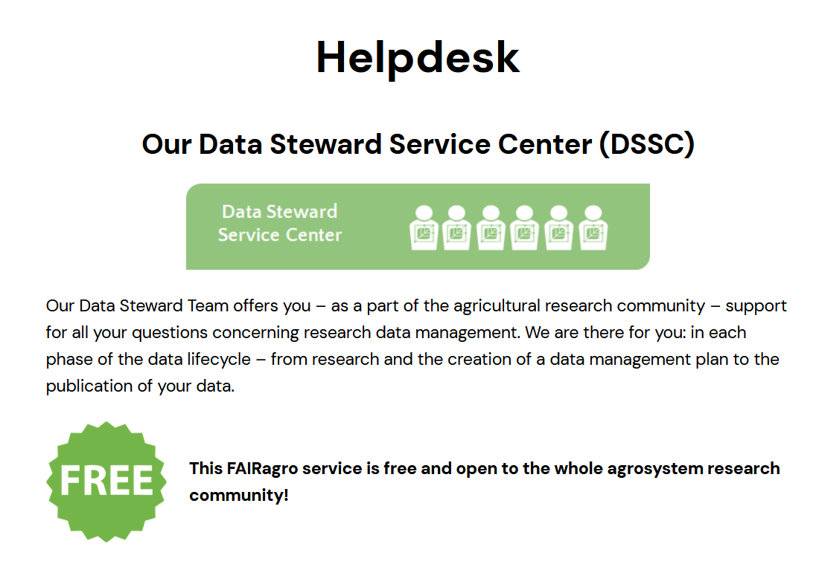
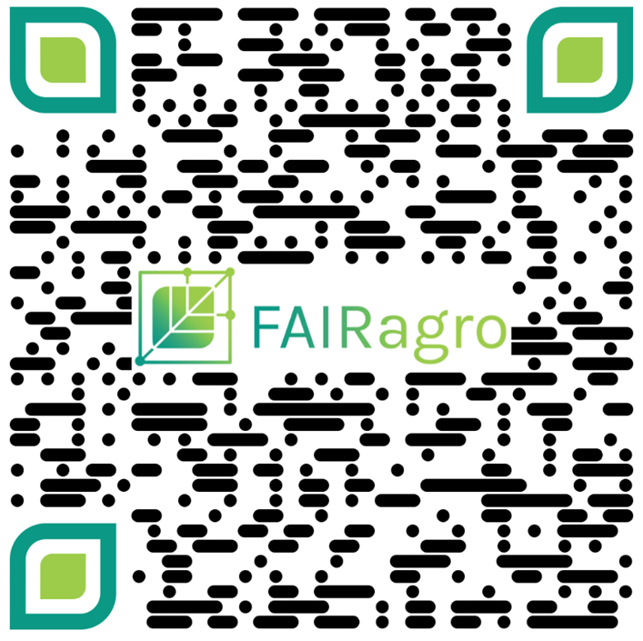
FAIRagro Helpdesk
fairagro.net/helpdesk
Notes:
Slide content:
A key service offered by the Data Steward Service Centre is our Helpdesk. This is a free and open point of contact for anyone in the agrosystem research community who needs assistance with any RDM queries arising from their day-to-day work.

